Slide 1
OṀ ŚRĪ SURABHI CAMPAIGN
GLOBAL JOINT VENTURE
ISKCON Daiva Varëäçrama Ministry – IDVM-INDIA
Ministry for Cow Protection/Agriculture - INDIA
Gau Raksha Indonesia (GAURI) - INDONESIA
Sustainable Eco Alliance (SEA.Inc.) – USA
Vedic Eco Village ((VEV) – CANADA
Mother Farm – UKRAINE

Slide 2
INVOCATION
namo brahmaṇya-devāya go-brāhmaṇa-hitāya ca jagat-hitāya kṛṣṇāya govindāya namo namaḥ
"My Lord, You are the well-wisher of the cows and the brahmanas, and You are the well-wisher of the entire human society and world."
(Vishnu Purana 1.19.65)

Slide 3
FIRST IS COW!
tratavyah prathamam gavah/tratah trayanti ta dvijan
gobrahmana paritrane/paritratam jagat bhavet
First of all cows should be protected.
Cows thus protected, will in turn protect the brahmanas.
Thus when protection of cows and brahmanas is achieved,
then the whole world is protected.
[Mahabharata, Harivamsa Parva, 55.31]

Slide 4
LOGO OṀ ŚRĪ SURABHI CAMPAIGN

Slide 5
IDEAL VEDIC ECO VILLAGE

Slide 6
CONTENT - A
Background (A- Pramana, B- ISKCON, C- Current History, D- Global Crisis)
Mission
Quotes from Srila Prabhupada
Global Strategy
Short-Term Objectives
Long-Term Objectives

Slide 7
CONTENT - B
Stakeholders
Sri Surabhi Global
Activities
Get Involved
Media (A- Audio, B- Books, C- Power Points, D- Documentary Videos)
Campaign National Directors
Contact Persons
Websites

Slide 8
BACKGROUND * A- – PRAMANA - VEDAS
Vedic Culture as Eternal Dharma for Humanity/Sanatana Dharma in 2 Features
“Dharmam tu saksad bhagavat-pranitam” [SB 6.3.19] [Dharma not man-made]
Bhagavat Dharma as Eternal “Spiritual Sva-Dharma” [First Feature]
Varnasrama Dharma as Eternal “Material Sva-Dharma” [Second Feature]
Both features are meant to coexist and nourish one another.

Slide 9
BACKGROUND * A- – PRAMANA - VEDAS
Sat Sandarbhas – Srila Jiva Goswami [Focus on Spiritual Sva-Dharma]
Dasa-Mula-Tattva – Srila Bhaktivinoda Thakura [Focus on Spiritual Sva-Dharma]
Char-Vidya [Kauthiliya’s Arthashastra) [Both Spiritual & Material Sva-Dharmas]
Anviksiki (Science of Philosophy) [1- Sankhya, 2- Yoga, 3- Tarka] For All Dvijas
Trayi (Science of Education) [14 Books of Knowledge] Brahmanas
Danda Niti (Science of Politics) [Protection/Admin/Welfare] Ksatriyas
Varta (Science of Economics) [Krishi/Go-Raksya/Vanijyam] Vaisyas

Slide 10
BACKGROUND * B- ISKCON in Perspective
ISKCON as Brahma-Madhva-Gaudiya-Vaisnava Sampradaya
ISKCON as a Religious, Cultural, Educational and Social Movement
Seven Purposes of ISKCON [Includes communities and general society]
“BOOKS are the Basis”, “PURITY is the Force”,
“PREACHING is the Essence” “UTILITY is the Principle”
* Social structure of Varnasrama mainly connected with UTILITY *

Slide 11
ISKCON’s FOUR MOTTOS
Books are the Basis
Purity is the Force
Preaching is the Essence
Utility is the Principle

Slide 12
ISKCON’s Four Mottos
Within ISKCON Today
Books are the Basis
Purity is the Force
Preaching is the Essence
Utility is the Principle
Books and Harinam
Temple Worship
Congregation Preaching
Varnasrama
Mission

Slide 13
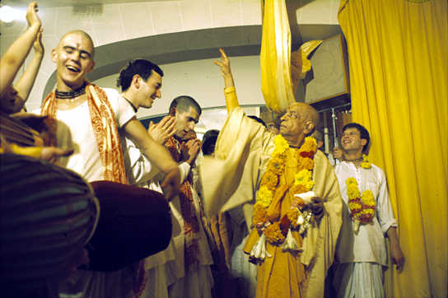
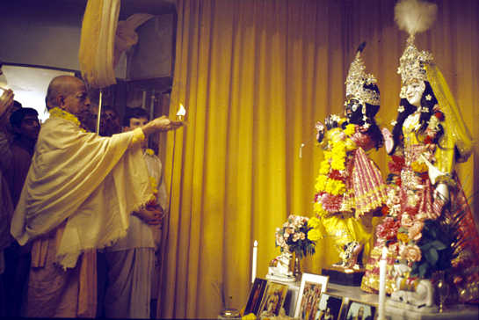
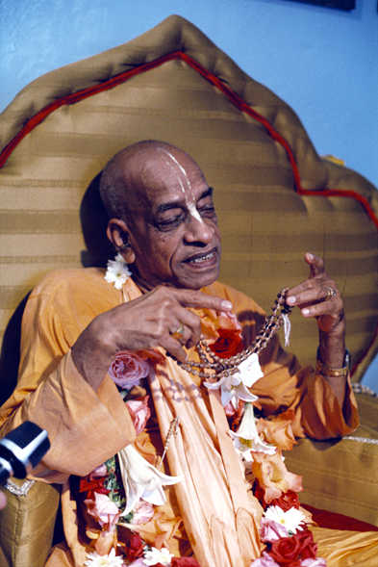
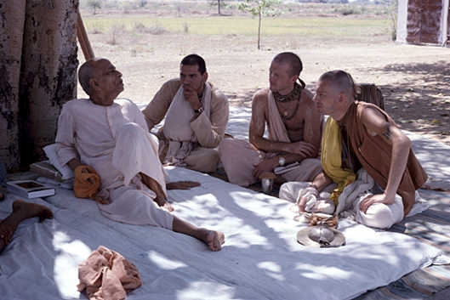
ISKCON’S 4 MOVEMENTS
1- SANKIRTAN MOVEMENT
2- TEMPLE WORSHIP MOVEMENT
3- SPIRITUAL INITIATION MOVEMENT
4- CLASSLESS SOCIETY MOVEMENT

Slide 14
ISKCON’s current activities have similarities with Srila Prabhupada’s Essay called “Gita Nagari”
Essay on Gita Nagari
Within ISKCON Today
Sankirtan
Temple Worship
Spiritual Initiation
Classless Society
Books and Harinam
Temple Worship
Congregation
Varnasrama

Slide 15
BACKGROUND * B- ISKCON
Four Movements of ISKCON – Essay on Gita Nagari
1. Sankirtan Movement (Holy Names/BOOKS) Bhagavat Dharma
2. Temple Worship Movement (Temples/Deities/PURITY) Bhagavat Dharma
3. Spiritual Initiation Movement (Congregation/PREACHING) Bhagavat Dharma
4. Classless Society Movement (Varnasrama Mission/UTILITY) Varnasrama Dharma
“Fifty percent of my mission is yet to be completed” – Srila Prabhupada

Slide 16
BACKGROUND * C- Current History
The OṀ Śrī Surabhi Campaign invoking “global auspiciousness” is an initiative of the ISKCON Daiva Varnasrama Ministry (IDVM-India) & the Ministry for Cow Protection – India.
Both National Ministries of India, recognizing the importance and urgency to promote Cow Culture Awareness, joined hands to launch the campaign in India on January 1, 2015.
Representatives from various NGOs and non-profits outside of India undertake a global joint venture to vigorously promote the OṀ Śrī Surabhi Campaign.

Slide 17
BACKGROUND D * GLOBAL CRISIS
MODERNISM (industrialization and urbanization) has disconnected individuals and society from land, cows, culture, tradition and spirituality.
As a result, Modernism is destroying three cardinal values of prime importance in the Vedic culture, namely 1) the Gift of Cows, 2) the Gift of Land and 3) the Gift of Knowledge. These three Gifts of Nature correspond to three mothers: 1) Mother Surabhi, 2) Mother Bhumi and 3) Mother Sarasvati.
This creates an unsustainable and artificial lifestyle causing severe global economic and social problems, with life-threatening ecological disasters.

Slide 18
BACKGROUND * D- GLOBAL STATISTICS
More than 150 billion animals slaughtered every year. (1)
Every year in the world there are an estimated 40-50 million abortions. (2)
Each year approximately one million people die from suicide/one death every 40 seconds. (3)
One farmer’s suicide every 30 minutes (India). (4)
(1) http://www.adaptt.org/about/the-kill-counter.html
(2) http://www.worldometers.info/abortions/
(3) https://www.befrienders.org/suicide-statistics
(4) http://www.thehindu.com/todays-paper/tp-opinion/One-farmerrsquos-suicide-every-30-minutes/article14875521.ece

Slide 19
BACKGROUND * D- GLOBAL STATISTICS
“DAILY” extinction is being inflicted upon 150 to 200 species of plant, insect, bird and mammal.
In 2016, more than 1.9 billion adults, 18 years and older, were overweight. Of these over 650 million were obese.
Globally, more than 300 million people suffer from depression, and 260 million suffer from anxiety disorders.
(1) https://www.globalresearch.ca/global-species-extinction-humans-are-now-the-asteroid-hitting-the-earth/5649235
(2) http://www.who.int/mediacentre/factsheets/fs311/en/
(3) http://fortune.com/2017/10/10/world-mental-health-day-2017-workplace-depression-anxiety/

Slide 20
MISSION
From January 1, 2015 to November 2, 2027, we commemorate an unprecedented Era of ISKCON Golden Jubilee Events thus giving us a golden opportunity to globally promote the concepts and principles of an Agrarian Vedic Culture.
Our twelve-year marathon aims at giving total protection to all forms of life, especially Mother Surabhi, by promoting a universal Cow Based Culture, traditional education, sustainable economy and lifestyle for global peace & prosperity all based on the teachings of the Bhagavad-gita and Srimad-Bhagavatam.

Slide 21
QUOTES FROM SRILA PRABHUPADA
“Therefore the world is suffering, so much sinful activities. The greatest sinful activity is cow slaughter, and they are committing. They do not know what will be the result.” [February 19, 1977, Mayapur]

Slide 22
QUOTES FROM SRILA PRABHUPADA
“The killing of cows by human society is one of the grossest suicidal policies and those who are anxious to cultivate the human spirit must turn their attention first toward the question of cow protection.” [Light of the Bhagavat, 27]

Slide 23
QUOTES FROM SRILA PRABHUPADA
“There should be a thorough overhauling of the social system, and society should revert to the Vedic principles, that is, the four varnas and the four asramas.” [SB.4.29.54]

Slide 24
QUOTES FROM SRILA PRABHUPADA
“This Krishna consciousness movement is for the protection of brahminical culture and cows. Then automatically the peace of the world will come, if (these) two things are done. This is Vedic literature. They pick up the essence of the things, and all other things follow.”
[Lecture, December 4, 1968, Los Angeles]

Slide 25
GLOBAL STRATEGY
During the twelve-year campaign (2015 to 2027), Continental Campaign Directors will systematically introduce and propagate the OṀ Śrī Surabhi Campaign in their respective continents.
The Continental Campaign Directors will select individuals to become National Campaign Directors and will train devotees who will travel and make presentations promoting the objectives of the OṀ Śrī Surabhi Campaign.
Through the Śrī Surabhi Global initiative, Serve Surabhi Members and Serve Surabhi Teams will help spread the Surabhi Campaign.

Slide 26
SIMPLE LIVING * HIGH THINKING

Slide 27
Short Term Goal-1 * Personal Oath *
The OṀ Śrī Surabhi Campaign gives an opportunity for individuals to take a lifelong pledge to always protect our Mother Surabhi.
A standard pledge can be taken anytime, especially at any official local launching ceremony of the campaign.

Slide 28
Short Term Goal-2 * Family Practices *
Play the Śrī Surabhi Mantra daily at home
Keep cow photos on the altar and walls at home
Use cow products such as soaps, incense, ghee
Recite daily prayers glorifying our Mother Surabhi
Go-Seva: weekly visit and seva to nearby Goshala
Go-Puja: daily offer incense and flowers to Mother Surabhi

Slide 29
Short Term Goal-3 * Green City Temples *
Hold seminars promoting Health, Yoga and Diet.
Teach about and encourage Community Gardens in cities.
Inspire temples to Lease or Purchase Land for the purpose of growing natural food, maintaining cows and developing self-sufficient communities.
Organize Yearly Fairs sharing experiences among temples.
Develop curriculum design for Home Schooling, Traditional Gurukulas & Varnasrama Colleges as desired by Srila Prabhupada.
Promote Serve Surabhi Membership and Serve Surabhi Teams.

Slide 30
Short Term Goal-4 * Ahimsa Milk *
Devotees should take milk only from protected cows.
Protected cows means those cows whom we know for certain will not be sent to the slaughterhouse, who are not milked by machines nor injected or fed with harmful substances.
Protected cows also means cows whose calves are protected for life and cows who have free access to water/grazing and not confined indoors.
Therefore, the importance for temples to have a farm project and for devotees to be connected with cows.
Devotees should also take A-2 category milk mainly found (but not exclusively) in pure breed cows, referred to in India as “desi cows”.
Devotees should research the A-1 category milk vs A-2 category milk controversy.

Slide 31
Short Term Goal-5 * Cooking in Ghee *
Avoid commercial oils, cook only in pure ghee.
All commercial oils (heat pressed as opposed to cold pressed) are contaminated and the cause of many diseases, including cancer.
Food Nutrients in the Body – Time Ratio (From Sacred Cows book)
Grains 5 days
Milk 7 days
Yogurt 20 days
Ghee 30 days
Srila Prabhupada has said that the only
oil we should put inside our body is pure ghee.

Slide 32
Short Term Goal-6 * Adopt a Cow *
Adopt a cow by supporting a goshala or purchase/maintain a cow.
One becomes immediately connected with cows when one adopts a cow.
Support the activities of devotees who maintain cows.

Slide 33
Short Term Goal-7 * Adopt a Village *
If villages disappear, cows will also disappear.
Urbanization is increasing at an alarming rate. Globally by year 2050 an estimated 50% of the world population will live in cities if the present trend continues.
Vedic culture is an agrarian-based culture where villages provide and support the most sustainable of economies, that based on natural agriculture using ox power.
“The immediate program should be
village organization as Mahatma Gandhi contemplated.”
Srila Prabhupada, April 20, 1975, Vrindavana

Slide 34
LONG TERM OBJECTIVES
Work towards having the United Nations and Countries adopt our Mother Surabhi as our universal mother/national emblem.
Help introduce legislation to stop cruelty to animals, especially the cows.
Encourage devotees/congregational members to take up important posts in the government administration in as many countries as possible.

Slide 35
LONG TERM OBJECTIVES
Demonstrate the benefits of an agrarian lifestyle, the superiority of a cow driven economy – Agrarian Revival through traditional technologies for a sustainable economic growth.
Promote Yoga, Vegetarianism, Natural Foods, Natural Farming.
Promote ahimsa food, ahimsa cloth and ahimsa medicines.

Slide 36
LONG TERM OBJECTIVES
Teach the harmful effects of chemical pesticides, chemical fertilizers, hybrid seeds and hard technology in farming.
Promote traditional occupation through traditional education
Help re-establish the concept of gochar bhumi providing ample grazing fields for cows.

Slide 37
LONG TERM OBJECTIVES
Educate organizations and governments about the merits of A-2 Category Milk as found in indigenous breeds (desi cows) and the potential demerits of A-1 Category Milk as found in non-indigenous breeds. Encourage more in depth study on the subject.

Slide 38
LONG TERM OBJECTIVES
Assist governments in reverting many of the critical global problems such as desertification and climate change by promoting natural large scale grazing of animals, especially cows and showing examples of a more simple and natural way of living in keeping with the concepts of simple living and high thinking.

Slide 39
STAKEHOLDERS
The present stakeholders from India, Indonesia, Canada, USA, Malaysia and Ukraine have been promoting a Cow-Based Culture in their respective countries for the last few years.
Each stakeholder agrees to become a “Serve Surabhi Host Team” for his country and actively promotes the aims and objectives of Śrī Surabhi Global on a voluntary basis.
Any registered Serve Surabhi Team from any other country may become a stakeholder by contacting any of the Continental and National Directors listed at the end of the presentation.

Slide 40
ŚRĪ SURABHI GLOBAL Promoting a Global Cow-Based Culture
Śrī Surabhi Global aims at introducing the Śrī Surabhi Mobile App launched on January 15 2018 (Android Version) and on May 20 2018 (iOS Version) in as many countries as possible (our target is 108 countries) to help promote the aims and objectives of the OṀ Śrī Surabhi Campaign: see the following link: http://www.srisurabhi.org/campaign-objectives/
Serve Surabhi Members who register as Serve Surabhi Teams may be selected as the “Hosting Agent” for their country. Sri Surabhi App registered members from each country will be cared for and serviced by their “Serve Surabhi Host Team”.

Slide 41
ŚRĪ SURABHI GLOBAL Three Levels of Involvement
1) SERVE SURABHI MEMBER
Individuals can register online to become a Serve Surabhi Member. On line application is available at http://www.srisurabhi.org/serve-surabhi/
2) SERVE SURABHI TEAM
Five Serve Surabhi Members can register as a Serve Surabhi Team in their area. Online application is available at http://www.srisurabhi.org/serve-surabhi-teams/
3) SERVE SURABHI HOST TEAM
Those interested to become the “Hosting Agent” for a particular country must fill in the “Sri Surabhi Hosting Team” MOU in keeping with the guidelines given by ISKCON-Daiva Varnasrama Ministry (IDVM-India), the initiator of the OṀ Śrī Surabhi Campaign. One may write to: info@srisurabhi.org for more details.

Slide 42
ACTIVITIES
Dedicated websites (see links at the end of the presentation)
Śrī Surabhi App (since 2018 Android and iOS versions available)
Cow Culture Conference in California (May 2018)
Documentaries (listed at campaign website and Sri Surabhi App)
Books (listed at campaign website)
Pamphlets (listed at campaign website)
Village Outreach programs (Dharma Go Gram Yatra)
Seminars/Conferences (www.srisurabhi.org)
Gurukulas & Varnasrama Colleges (Various levels of developments)
WhatsApp Social Media Groups (Global Varnasrama Mission)

Slide 43
GET INVOLVED
Become a “Serve Surabhi Member”
Register a “Serve Surabhi Team” in your country
Be selected as the “Serve Surabhi Host Team” for your country
Download the Śrī Surabhi Mobile App (Android or IOS)
Become a National/State/Provincial/District/Village Director
Become a Subscriber Member of the OṀ Śrī Surabhi Campaign
Become an active Campaigner
Become a Correspondent of the OṀ Śrī Surabhi Campaign
Adopt as many Best Practices as possible to increase awareness

Slide 44
MEDIA * AUDIO
Śrī Surabhi Mantra [www.srisurabhi.org]

Slide 45
MEDIA * BOOKS (Partial List)
Make Vrindavan Villages
Speaking About Varnasrama
My Spiritual Lamentation
Traditional Education
Village Life
Campaigners’ Guide
Save our Cows, Save our Villages, Save our Culture
Modernity is Killing Civilization
http://www.srisurabhi.org/shop/?product_orderby=name

Slide 46
MEDIA * POWER POINTS (Partial List)
Namo Gobhyah by HG Revati Raman das 32 Slides
Vedic Economy by HG Vishnunama das 41 Slides
Varnasrama College-Curriculum by HH Bhakti Raghava Swami 35 Slides
Venu Madhuri by HG Rupa Vilasa das 40 Slides
Lifestyle Medicine.ppt by Dr. Gopinath das 30 Slides
Holistic Cow Protection by Dr. Sree Kumar 72 Slides
Vedic Sociology by HH Bhakti Raghava Swami 40 Slides
Natural Agriculture by HG Sanat Kumar das 50 Slides
Brahmana Varna by HG Gaura Nataraj das 35 Slides
The Science of Politics by IDVM-India 25 Slides
* All available at www.srisurabhi.org *

Slide 47
MEDIA * DOCUMENTARIES (Partial List)
The Story of Stuff [https://www.youtube.com/watch?v=9GorqroigqM&vl=en]
Rock Story [www.srisurabhi.org]
Life is Easy. Why make it hard? [https://www.youtube.com/watch?v=21j_OCNLuYg]
Interviews on Varnasrama [www.sri-surabhi.org]
Documentary Surabhi Campaign [www.srisurabhi.org]
The End of Suburbia https://www.youtube.com/watch?v=yYFPx6nMOXU
An Inconvenient Truth https://www.algore.com/library/an-inconvenient-truth-dvd
Before the Flood https://www.beforetheflood.com
Cowspiracy/The Sustainability Secret https://www.youtube.com/watch/?v=9ZZY8s3tDrM
Vedic Sociology/Part 3/Economy https://www.youtube.com/watch?v=YzD-3jHslMw
POWER POINTS… [www.srisurabhi.org]

Slide 48
OṀ ŚRĪ SURABHI CAMPAIGN DIRECTORS
CANADA HG Bala Krishna das (Director) bforganics@gmail.com
INDIA HG Damodar Dulal das (Co-Director) damodardulal.rns@gmail.com
INDIA/ASIA HG Sri Rama das (Co-Director) sriramadasa.brs@gmail.com
INDIA HG Rajaram das (Co-Director) rajaram.brs@gmail.com
INDONESIA HG Kisora das (Director) kisorakrsna@yahoo.com
CAMBODIA HG Guna Avatara das (Director) gunaavatara.dasa@yahoo.co.id
MALAYSIA Jonson Chong (Director) jonsonchong@gmail.com
AMERICA NORTH HG Sri Krishna P. das (Director) sreekanth.brs@gmail.com
USA HG Daiva das (Director) leafhawaii@gmail.com
UKRAINE/RUSSIA HG Yamuna Prana das (Director) a.evstratko@gmail.com

Slide 49
CONTACT PERSONS
CANADA/Ramanath das villageinternet.ca@gmail.com
CAMBODIA/Kumudaksa das kumudaksa.dasa@gmail.com
INDIA/Bhakti Raghava Swami bhakti.raghava.swami@pamho.net
INDONESIA/Yadhava Hari das yadunandana108@gmail.com
MALAYSIA/Rasikananda das ramabrintha@yahoo.com
UKRAINE/Simon simon.kis.das@gmail.com
USA/Sri Krishna P. das sreekanth.brs@gmail.com

Slide 50
WEBSITES
CANADA www.vedicecovillage.ca
CAMBODIA http://www.iskconcambodia.com
INDIA www.srisurabhi.org
INDONESIA www.gauri.or.id
UKRAINE www.mother.fund/en/
USA www.sustainableeco.org

Slide 51
ŚRĪ SURABHI MANTRA
OṀ ŚRĪ SURABHYAI NAMAÙ
HARE KRISHNA MAHA MANTRA
Hare Krishna Hare Krishna Krishna Krishna Hare Hare
Hare Rama Hare Rama Rama Rama Hare Hare

